Slide 1
ComArts Accessibility Review
April 2022

Slide 2
Spring Semester Average Ally Scores 2022 By Department
College of Communication Arts and Sciences – 81%
Journalism – 69%
Advertising and Public Relations – 67%
Communication & Communicative Sciences and Disorders – 65%
Media and Information – 54%
Average – 67%

Slide 3
Percent of Courses that have an Ally Score of 80% or Higher (a Good Ally Score)
Communicative Sciences and Disorders – (51/58 courses)
Advertising and Public Relations – (25/30 courses)
Communication – (12/15 courses)
Media and Information – (64/85 courses)
College of Communication Arts and Sciences –(30/54 courses)
Journalism – (8/24 courses)

Slide 4
Percent of Courses that have an Ally Score of 30% or Lower
Advertising and Public Relations – (2/85 courses)
Journalism – (3/54 courses)
Communicative Sciences and Disorders – (1/15 courses)
College of Communication Arts and Sciences – (2/24 courses)
Communication – (8/58 courses)
Media and Information – (5/30 courses)

Slide 5
For Content Improved Directly Using Ally Feature
Since Ally went live in August 2020; does not include content downloaded and reuploaded
Journalism – 65% difference (24% to 89%)
Advertising and Public Relations – 59% difference (28% to 87%)
Communicative Science and Disorders – 57% difference (6% - 63%)
College of Communication Arts and Sciences – 56% difference (34% - 90%)
Communication – 40% difference (24% to 64%)
Media and Information – 38% difference (52% to 90%)
Insights: Though the feature is used infrequently, there is a huge increase in the Ally score when it is used

Slide 6
Launched Course Accessibility Ally Report
Journalism – 118 times in 665 total courses
Advertising and Public Relations – 168 times in 2773 total courses
College of Communication Arts and Sciences – 61 times in 1096 total courses
Media and Information – 59 times in 1353 total courses
Communication – 57 times in 2231 total courses
Communicative Science and Disorders – 4 times in 1142 total courses
*Total courses since Ally went live in August 2020; excludes Accessibility teams edits
Insights: This feature is not used often

Slide 7
Total
Advertising and Public Relations Department
Communicative Science and Disorders Department & College of Communication Arts and Sciences
Journalism Department
Communication Department
Media and Information Department
Meaning: Total of every ranking for each category.

Slide 8

Start of SIS Accessibility Presentation

Slide 9
 | Past | Now | Potential course of action 1 | Potential course of action 2 | Potential course of action 3
Course selection | Only some, past course | All current courses | All current courses | All current courses | All current courses
Priority | Online | Lowest Ally score with greatest number of content | Lowest Ally score with greatest number of content | VISAs, Lowest Ally score with greatest number of content | Goal Oriented
Process | Interns remediating Course consultation | Intern remediating Course consultation | Set up meeting Review content before Meet with suggestions | Look over select course Email suggestions Offer to set up meetings | Set goals Mass emails Zoom office hours with suggestions

Slide 10
What we did in the Past
Selection of courses: Only a portion of the classes from every semester to be remediated; Can remediate past courses
Priority: Online courses take priority combined with high enrollment courses regardless of Ally score
Remediation process:
  We go into the course and remediate
  Once we are done, we let professor know and go over changes and recommendations

Slide 11
Benefits and Drawbacks of what we did in the Past
Benefits
Online courses usually have more content
Courses that are remediated end with really good Ally scores (many times above 90%)
Drawbacks
Many hybrid and in-person courses have a lot of online content
Very slow
  Our team has fully remediated 24 courses since Spring 2020, 9 partially
Ran out of courses
Past courses could not be relevant now

Slide 12
What We Are Doing Now
Selection of courses: All of the ComArts classes can be remediated but only in the current or future semester, unless the same professor is teaching it again
Priority: Courses with the greatest number of pieces of content combined with the worst Ally score, disregard different sections
Remediation process:
  We go into the course and remediate
  Once we are done, we let professor know and go over changes and recommendations
Same

Slide 13
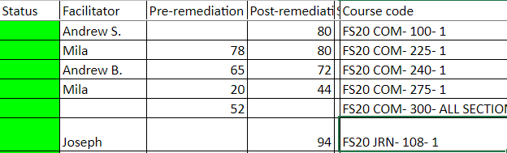
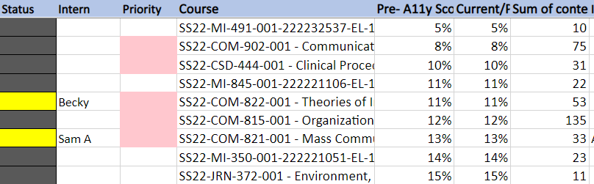
What we did in the past
What we are currently doing

Slide 14
Benefits and Drawbacks of Current Process
Benefits
All types of courses
End with really good Ally Scores
All courses remediated need it, though not all that need it get it
Drawbacks
Very slow
Not sustainable
There are too many courses to keep up with.
  Out of 245 courses this spring, 60 are under 50%
  The average score of those 60 is 35% with 39 pieces of content

Slide 15
Potential Course of Action 1- Support
Same
Selection of courses: All of the ComArts classes can be remediated but only in the current or future semester, unless the same professor is teaching it again
Priority: VISA courses, Courses with the greatest number of pieces of content combined with the worst Ally score
Remediation process:
  Look over course and provide them with suggestions on how to remediate course over email. Suggest setting up an optional meeting.
  Before the meeting, we view the changes they have made to their own content to give any suggestions. We plan any additional meetings.
  We may have to help with complex content.

Slide 16
Potential Course of Action 2 – Required Meetings
Same
Selection of courses: All of the ComArts classes can be remediated but only in the current or future semester, unless the same professor is teaching it again
Priority: VISAS, courses with the greatest number of pieces of content combined with the worst Ally score
Remediation process:
  We email professors of our target courses, and provide them with recommendations on how to remediate course.
  We tell them to start remediating content then give them X weeks (depending on # of pieces of content) and plan a day to meet up again.
  Before the meeting, we view the changes they have made to their own content to give any suggestions. We plan any additional meetings.
  We may have to help with complex content

Slide 17
Benefits and Drawbacks of Plans 1 & 2
Benefits:
Courses remediated quicker
Calls for accountability on the parts of the professors
May be more sustainable if professors can learn how to do things themselves
Will raise very low Ally scores that might not be hard to fix
VISA courses will be fixed
Drawbacks:
May still have to help with complex internet PDFs especially if they don't have Adobe
May overwhelm professors
Perfect accessibility scores will be unattainable

Slide 18
Potential Course of Action 3 – Email Campaign
Same
Selection of courses: All of the ComArts classes can be remediated but only in the current or future semester, unless the same professor is teaching it again
Priority: Based on goals
Remediation process:
  Set accessibility goals for each department
  Mass email professors with courses that are under our goals (example: under 40% ally score) letting them know and provide with tutorials
  Offer Zoom drop-in meetings
  Frequently update on goals via mass emails

Slide 19
Benefits and Drawbacks of Plan 3
Pros:
Having bigger goals and frequent emails may increase interest in more accessible content
Healthy competition between departments could raise score
Cons:
May not work because there is a lack of accountability

Slide 20
Thoughts?

